Slide 1
Forth Sprint
Team RCM
By: Ramiro Gamboa Montes, Christopher Ramirez, Maggie Hemond

Slide 2
Our Hopes & Dreams
What we wanted to get done:
Portfolio Page:
Fix the portfolio’s get rid of stock, Gain/loss of all of portfolio*
Settings:
Font Size in Settings, FAQ dropdown
Backend:
Add firebase, add alpha vantage, allow more info and change how info is to be requested. Fix the errors that occur when changing what the backend sends to the front end.
Home page:
Put in the fake money to buy stocks

Slide 3
Back-End: The Harsh Reality
Endpoint NEW format (kept render): /stock?symbol=<function>:<parameter>
Functions
Autocomplete (via finnhub)
Usage example: /stock?symbol=autocomplete:AAP
Returns up to 50 matches, each including: symbol, displaySymbol, description, type (Ex. Common Stock, ETP, Crypto, etc.)
yfinance
Usage example: /stock?symbol=yfinance:AAPL,MSFT
Returns detailed stock info for each symbol, including: company name, current price, timestamp, 30‑day closing‑price history
How it works
The word before the colon (autocomplete or yfinance) selects which function to run.
Everything after the colon is passed as the search term or list of tickers.
Results are returned as JSON arrays, ready for the front end.

Slide 4
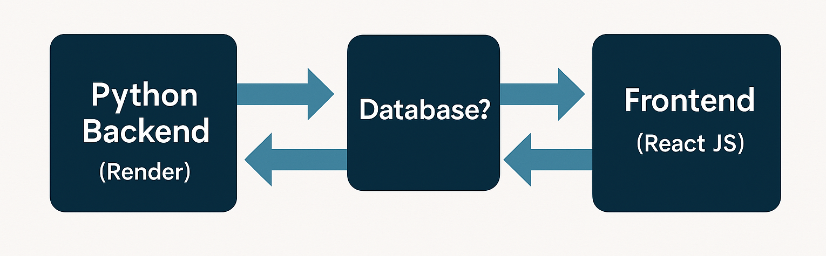
Future Backend Enhancements
Returning more info: We have returned company name, current price, timestamp, 30‑day closing‑price history. We can look at what else we can return so people can make decisions regarding stock.
Firebase authentication: We need to store people's portfolios at some point since we are a web-app and do not have local storage. This will be added via firebase, we will no longer be considering using firebase functions for hosting our functions/API, only for authentication and profile storage.

Slide 5
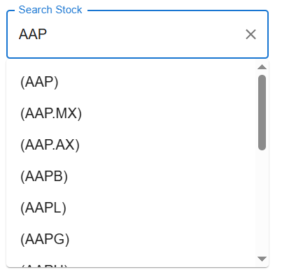
Stock Page: Current News
Worked on:
Autocomplete Feature: Added the functionality of the autocomplete from the API. Typing a letter will return up to 50 potential matching stocks.
Preview button: Now able to "preview" stocks as since you get just the name of a stock from the auto complete now you get the.

Slide 6
Settings: Current Developments
Worked on:
Font Size in Settings, when you click the button the paragraphs font size gets bigger
We turned the FAQ into a dropdown, just have to hover over the question
(all of this is shown in the demo)
Portfolio Page: Current Developments
Worked on:
The portfolio's get rid of stock got broken. Fix the portfolio’s get rid of stock (simple bug fixes!)
Home: Current Developments
Not worked on:
Did not have time to put in the fake money

Slide 7
Future Developments
Want to work on if we have time and decide which is more important:
API Security: Currently, the API endpoint is public; implement authentication to restrict access.
Portfolio:
Gain/loss of all of portfolio
save portfolio so it does not disappear (more of an api thing)
Fake money and add it to the other pages
Stock page: Method of presentation on stock page (EndLess scroll and sections
Settings Page: Ensure all aspects of dark mode, work, such as with the home screen, and with the dropdown menu

